Slide 1
Just Another Movie
Presentation
Emmett Storey, Kaitlyn Hardin, Hayden Richards, Robert Jones

Slide 2
Introduction
Just Another Movie is a movie recommendation desktop application. Our purpose for creating this application is to improve the movie watching experience by eliminating the strife of finding a movie. In our application, users will be able to generate a list of recommended movies from our vast collections of movies.
The application will take the user’s input and use our AI model to return a list of movies that the user should enjoy.

Slide 3
Technology
Technologies that were used
Visual studio
C#
Python
SQL
ML.NET
WPF
Kaggle dataset
Github

Slide 4
Technology
How difficult was it to come up speed?
Everyone had to use technology or use a programming language that they were unfamiliar with.
Did the technology you choose actually help solve the problem?
Yes, the only technology that was more of a pain than was helpful was the kaggle dataset.

Slide 5
Design: Frontend
LoadScreen
SearchScreen
ResultScreen
NoResultsScreen
SurveyScreen
MovieInfoScreen
Buttons:
Help
Get list
Close
Search
Next
LoadMoreMovies
LoadNextMovies

Slide 6
Design: Frontend
Startup
Displays the name of the application
Includes tutorial of how to use
Next button to proceed to search screen
Exit to close
Search Screen
Allows user to input data information such as Author, Genre, Year and Director
Includes button such as next, previous and get list to populate list
Results Screen
Displays recommendations from previous users

Slide 7
Design: Backend
Backend - Functions as an intermediary between the frontend and backend.
UserInput - Handles the input from the User
MovieList - Holds of list of Movie class objects and what is passed from the backend to the frontend
Movie - Holds data such as the title, director, actors, genre, and year of a movie.
Query - Interacts with the database and checks and retrieves if movies meet userInput requirements.

Slide 8
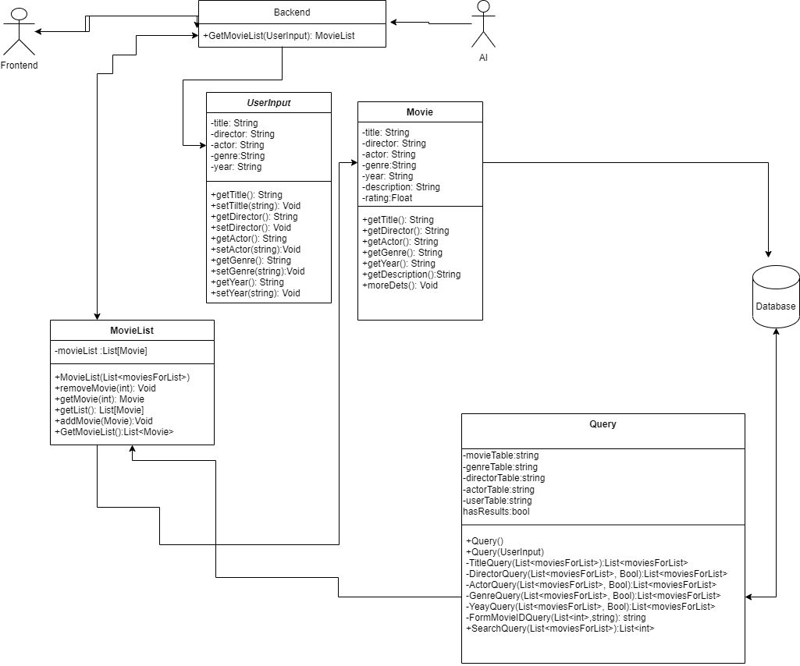
Backend Diagram

Slide 9
Design: AI
AI - Is the class that builds and trains the AI to make recommendations.
moviePrediction - Is the class that works as the output for the AI and stores the movie ID and predicted rating the user would give.
movieRatings - Is the input class for the AI which holds the movieID user ID’s and ratings to be able to train teh AI.
moviesForList - Is the class that holds the recommended movies with the scores

Slide 10
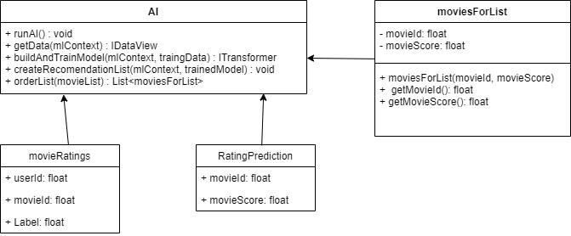
AI Diagram

Slide 11
DataBase: Design
Movies- stores movies’ movie id, title, description, and release year.
Genres- stores the genre ids and genre names
Actors- stores all actor names and actor ids from all movies
Directors- stores all director names and director ids from all movies
MovieGenres- stores the movie id and the genre id of the genre for the movie
MovieActors- stores the movie id and the genre id of the genre for the movie
MovieDirectors- stores the movie id and the genre id of the genre for the movie

Slide 12
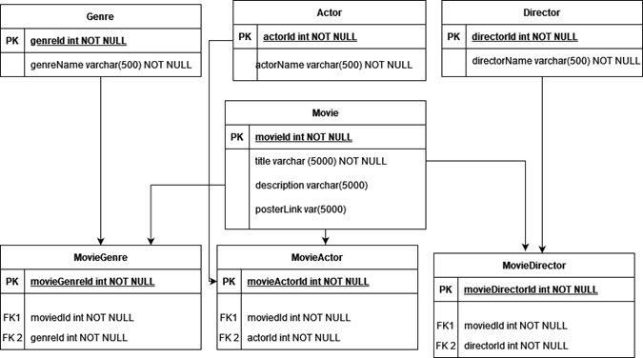
DataBase Diagram

Slide 13
How to Deploy
The user can simply just download the application and create a shortcut and simply run the application to get started.
The user will be greeted with a welcome screen that has directions on how to use the application,

Slide 14
Known Bugs: Frontend
Results screen
Cannot display the movie posters
Load More Movies and Load Previous Movies buttons do not work
Cannot load all movie titles
Backend|Frontend|Database
MovieInfo screen
Cannot display all movie information
Backend|Frontend|Database

Slide 15
Known Bugs: Backend
Some Information cannot be retrieved by the frontend
though what cannot be retrieved varies by movie

Slide 16
Know Bugs: AI
The AI pulls the data from the csv file that is located in the debug folder instead of the data folder that was created to hold the data.

Slide 17
Known Bugs: Database
Includes empty values for important movie information
Title, Year, etc.
Unknown extraneous values
Foreign movies, special symbols

Slide 18
Future Work: Frontend
Make the UI look better and more user friendly.
Fix display issues
Successfully implement Load More Movies/ Load Previous Movies
Implement more functionality to improve UI experience

Slide 19
Future work: Backend
Allow for use of removal of a movie from the list by the frontend.

Slide 20
Future Work: AI
Build the model from the ground up.
Keep track of liked movies by the users and make the predictions based off of that instead of having the survey.
Get rid of the survey.

Slide 21
Future Work: Database
Clean database
Remove records with empty values
Manage special characters and foreign symbols

